Slide 1
AOPA Brasil: a brief overview

Slide 2
AOPA Brasil at a glance
Founded in 1972, part of IAOPA - International Council of Pilots and Aircraft Owners Associations almost since the same time. Today we have almost affiliated 200 members. Our job is 100% voluntary.
As almost all of us here in this meeting, our work is driven to keep and to develop the general aviation as a core component of the Brazilian aviation system.
For decades we keep and work to flourish our relationship in all most relevant local aviation stakeholders, including but not limited to ANAC (National Civil Aviation Agency) Board, Brazilian Airspace Control Planning Group, being one of the founders of BGAST (Brazilian General Aviation Safety Team).
Acting through political and technical reputation built along the last decades, we are continuously working in airspace rules, airports, pilots' licenses and qualifications, operating regulations, customs, taxes and fees policies, aeronautical certification, meteorology and navigation equipment requirements for aircrafts under our Part 91 environment.

Slide 3
Brazilian Aviation in Figures
Almost 2.500 airfields, ~140 of them served by regular commercial flights
Currently, around 10k airworthy aircrafts, 450 flying under Part 121, all the others under Part 135 and Part 91
Out of 9,5k airworthy aircrafts, we find:
~ 4k piston single engine
~ 0,5k piston single turboprop
~ 0,5k twin piston engine
~ 1k twin turboprop
~ 1,5k jets
~ 2k helicopters
30k pilots

Slide 4
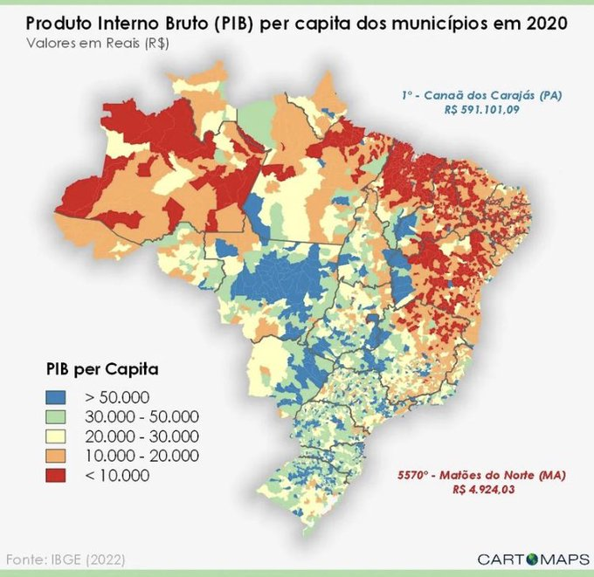
Our aircraft distribution has strong correlation with our GDP geographical distribution, almost 80% of it in the South, Southeast and Midwest regions.
In the last 10 years the General Aviation has started to be heavily used as part of several business, most of them connected with the agriculture expansion and major local corporations going global.

Slide 5
Our recent major battles and opportunities
Along the last decades we worked hard to make the general aviation operationally feasible in Brasil
Despite the obvious strategic asset that the general aviation represents in a country like ours, we struggle very much to keep general aviation alive
Avoid (or, most of the time, invest all our time to fix what came out of the blue from the authorities) disproportional regulation in all dimensions: pilot certification, aircraft ownership, access to airports and the airspace
Protect against more and more taxation on every single angle of owning and operating a private aircraft
Our main opportunities for now
Access to airports – the combination of wrong incentives with fragile regulation to protect access for the general aviation - is threatening our business via access blocking (costs + operation slots + parking restrictions)
Support flourishing of private airports dedicated to general aviation
Liberalize and amplify the fuel distribution through self-services pumps
Opening the Brazilian flight plan system to all market of navigation apps
Be prepared for the next aircrafts generation penetration (E-VTols, Drones, AI…)

Slide 6
Thank you!

